Slide 1
Settlement Workstream
Mojaloop Open Source Community Meeting
Presented by Michael Richards, Sam Kummary & Jason Bruwer
26 March 2024
‹#›

Slide 2
Agenda
Background & business requirements
New Settlement in current Prod. release
Performance Testing
‹#›

Slide 3
Background &
business requirements
Settlement Workstream
‹#›

Slide 4
Our objectives
Fully flexible settlement models
The ability to support small settlement batches
Deterministic assignment of payments to settlement batches
Allow administrators to settle by criteria, not by batches

Slide 5
Fully flexible settlement models
Support all the types of settlement found in the real world.
Contain criteria for assigning payments to settlement models.
Contain criteria for assigning payments to batches.
Allow administrators to view payments and settle them by characteristics, not batch identifiers

Slide 6
Settling by criteria
Decouple settlements from settlement batches
“All payments between midday and 16:00 yesterday”.
This creates an actionable matrix…
Its content can be dynamic
An administrator can take actions on the matrix
Which doesn’t mean that the action will be taken on every batch

Slide 7
Taking actions on a report
A matrix can contain batches which are actionable:
Batches that are closed
Batches that might still have transfers added to them
And batches which aren’t:
Batches that are in dispute
Batches that are marked for settlement in another matrix.
When you look at a matrix, you can see:
The total of all payments in the matrix.
The total of actionable batches in the matrix.

Slide 8
Sounds complicated, but:
We’re focusing on making standard practice simple..
That means that the edge cases and the error cases are more complicated to develop…
We think that’s a trade-off worth making.

Slide 9
New Settlement service with
current Production release
Settlement Workstream
‹#›

Slide 10
New Settlement in vNow
Workshops (scope & effort) - in progress
Main areas that will be impacted:
Fulfilment (enrich Kafka event to fyi Settlement framework)
New front-end to support the new Settlement Admin API for Hub operators
Processing of the settled events in order to update participant liquidity and position accounts
‹#›

Slide 11
New Settlement in vNow
Current Fulfil handler to generate a message that can be readily consumed by the new Settlement service
Upon settling (of a Settlement Matrix), a new handler to generate messages (or initiate calls) to adjust position and settlement account balances based on the settlement message
New Settlement to accommodate immediate / continuous settlement (to be capable of replacing all of the current settlement services)
Front-end for Hub Operators by integrating with Finance Portal
‹#›

Slide 12
Performance Testing
Settlement Workstream
‹#›

Slide 13
Performance Testing
Environment
Testing process
Test cases
Observations
‹#›

Slide 14
Test environment
Env | Resources | Services | Hosted * (single instance)
1 - Modest 20 operators | 4 CPU 16GB RAM AMD EPYC 7000 processors | Docker compose TigerBeetle (single node) Settlement (not clustered) MongoDB Kafka Redis Elastic stack Prometheus | AWS m5a.xlarge
2 - Amped up 50 operators | 16 CPU 64GB RAM AMD EPYC 7000 processors |  | AWS m5a.4xlarge
* Fairly suitable for small to mid-sized databases
Reference: https://aws.amazon.com/ec2/instance-types/
‹#›

Slide 15
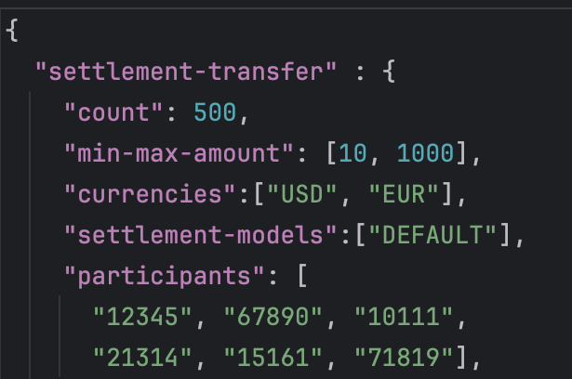
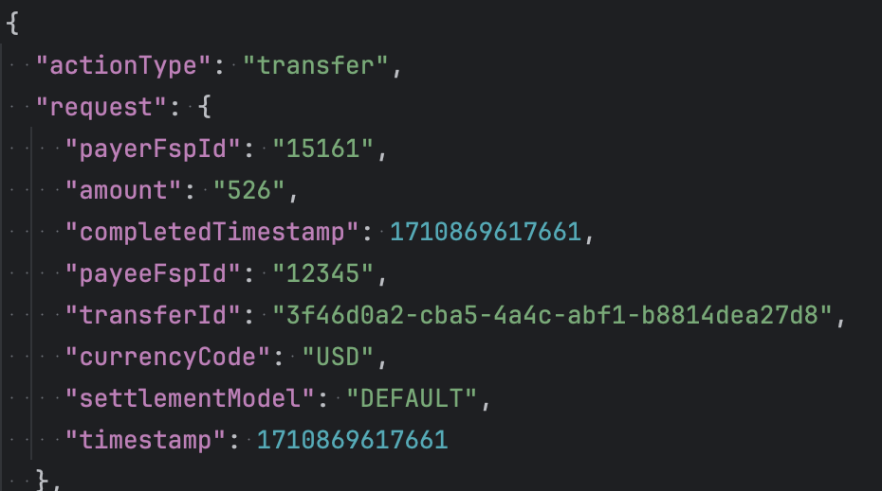
Testing process
Configure
Output test data
1 - generates
plan & configure the:
transactions, amounts, currencies, models, participants, lookups
settlement operations etc.
predictable test data:
contained in a single JSON file
2 - execute tests
sends test data into Settlement service via jMeter
END
‹#›

Slide 16
Test cases
Simulated 20 to 50 operators or processes running concurrently:
cleared transfers:
automatically allocated to settlement batches throughout the day
close settlement batches
lock batches for settlement
lookup transfers from settlement batches
finalise reports for settlement
view settlement reports
‹#›

Slide 17
Results?

Slide 18
Modest environment
Simulated 20 operators
Multiple settlement processes concurrently
Same tests on different databases: MongoDB only; with TigerBeetle
‹#›

Slide 19

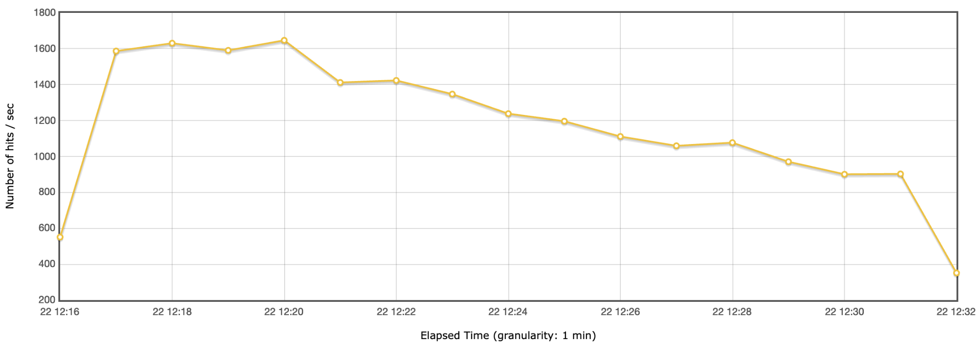
Volumes (modest env)
‹#›

Slide 20

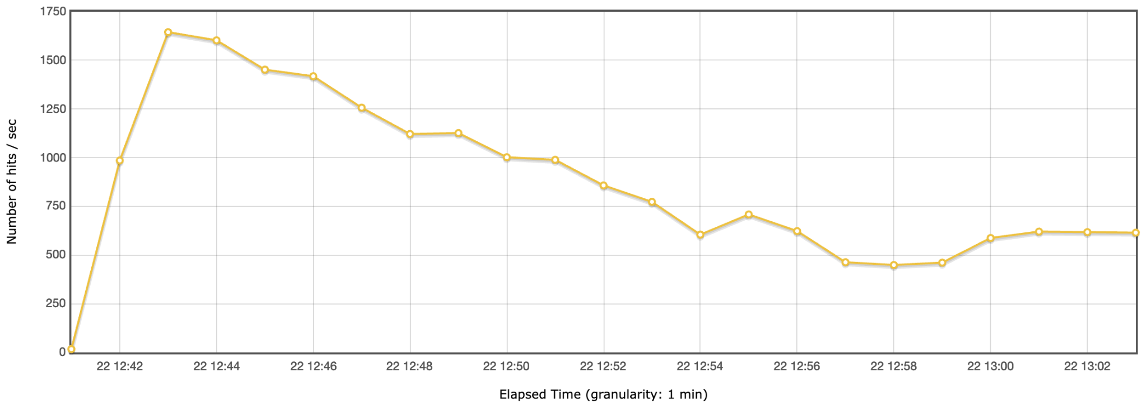
Volumes (modest env)
‹#›

Slide 21
Amped-up env
Simulated 50 operators
4500~ transactions per second
Multiple settlement processes concurrently
Same tests on different databases: MongoDB only; with TigerBeetle
‹#›

Slide 22
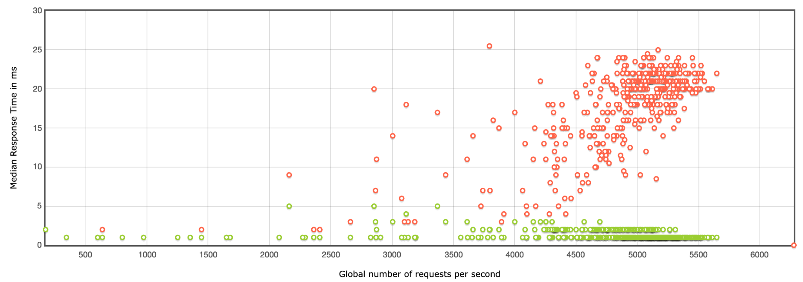
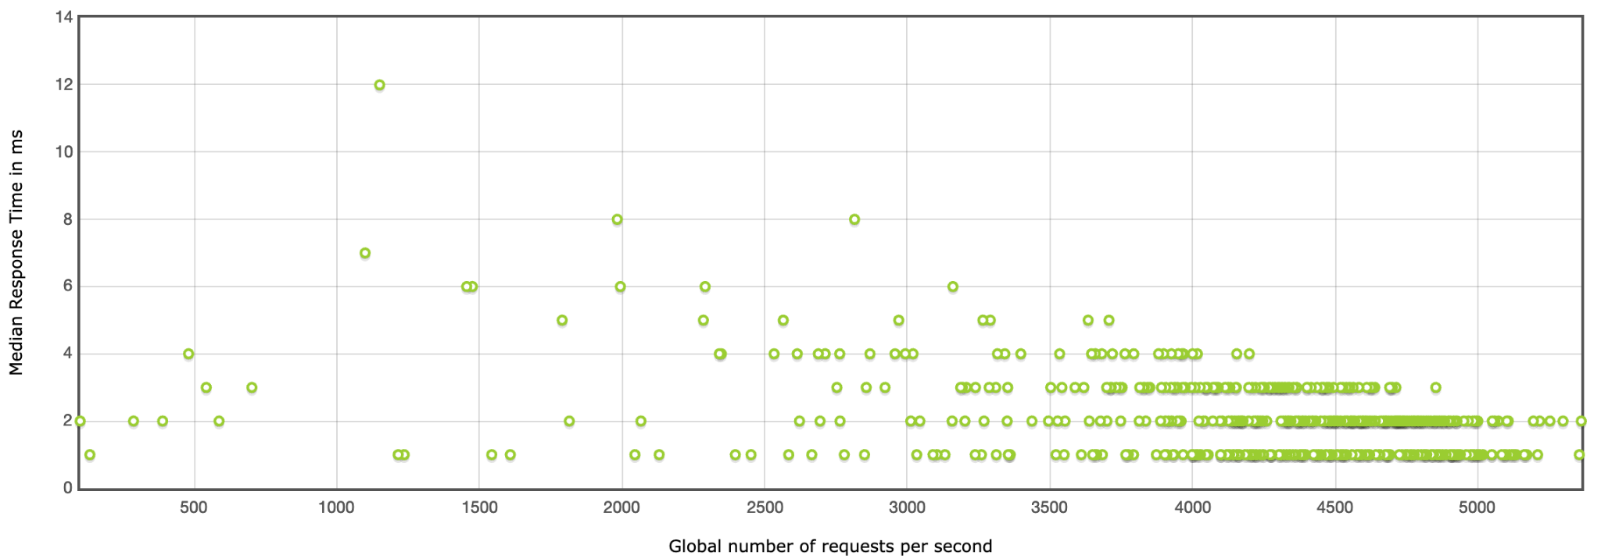
Response times (amped-up env)
‹#›
Notes:
Red indicates failures, where the Settlement service was unable to service the request
Very important to note that these were conducted under very stressful testing, that would highly unlikely mimic a production like environment.

Slide 23
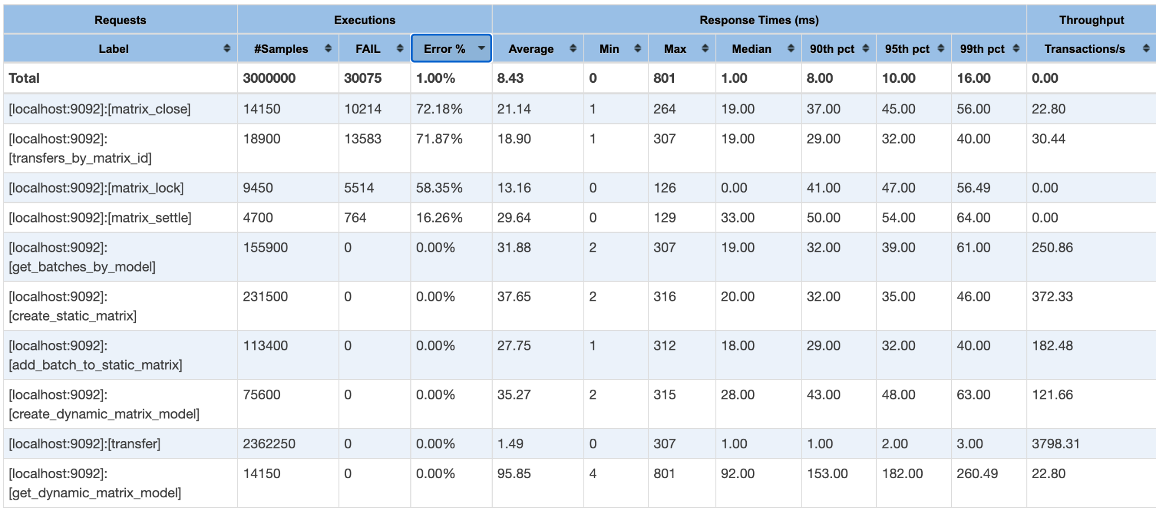
Observations (amped-up env)
‹#›

Slide 24
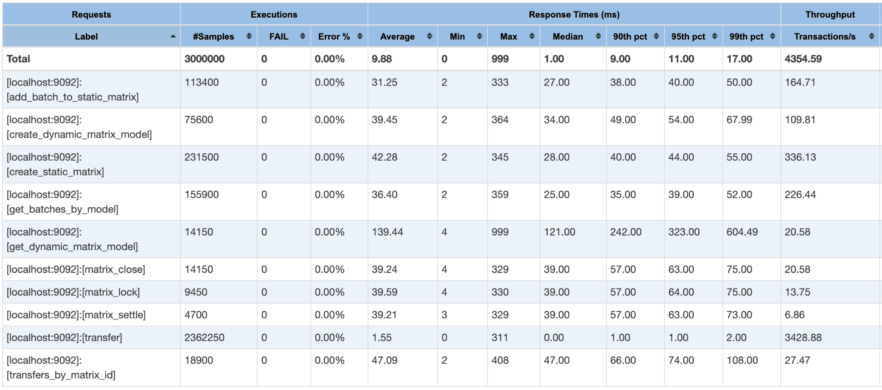
Observations (amped-up env)
‹#›

Slide 25
Amped-up env
Simulated 50 operators
Only allocating cleared transfers to settlement batches
Different databases:
MongoDB only
with TigerBeetle
‹#›

Slide 26
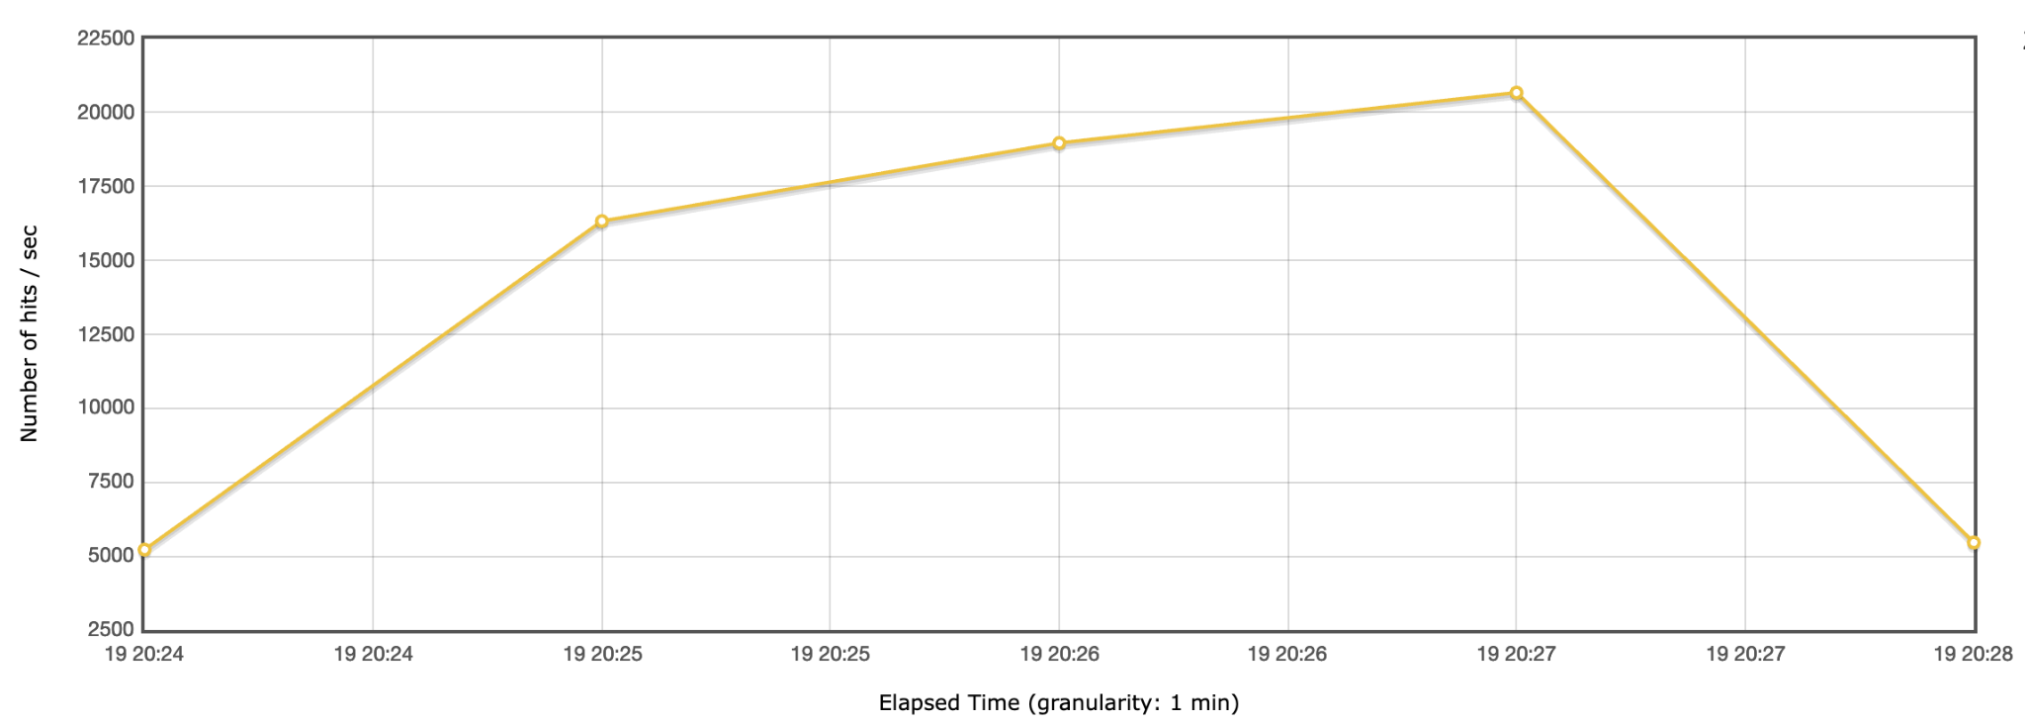
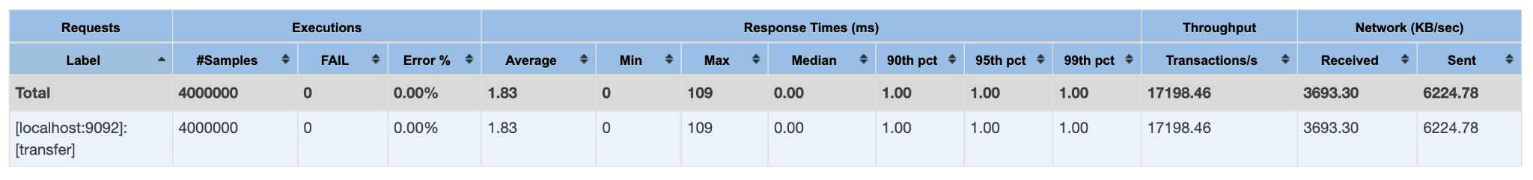
Volumes (amped-up env)
‹#›

Slide 27
Test suite
Devs or Hub Operators can simulate test scenarios - config only
Generate test data based on config
Replay or recreate test cases
Run in different environments
Compare behaviour with similar test data
‹#›

Slide 28
Other points of interest
TigerBeetle updates
historical balance queries
Redis upgrade
instant batch allocation
‹#›

Slide 29
Thank you!
‹#›

